Slide 1

Health
Passport
25/11/2017
MÜNCHNER KREIS and IBM Blockchain Hackathon
Notes:
To use this title animation slide with a new image simply 1) move the top semi-transparent shape to the side, 2) delete placeholder image,
3) click on the picture icon to add a new picture, 4) Move semi-transparent shape back to original position, 5) Update text on slide.

Slide 2
“A good physician treats the disease, the great physician treats
THE PATIENT WHO HAS THE DISEASE.”
WILLIAM OSLER

Slide 3
INTRODUCTION
No Data stored
- Every doctor has separate file of patient.
A problem in the health system today is the lack of data transmission
Health background from patient
- in emergencies, patient’s history isn’t available
Loss of time
- data collection from patients takes time
- getting data from former doctors is tedious

Slide 4
ISSUES
Storing data in a single place brings along difficulties
Sensitive Data
Security Issues
Legal limitations

Slide 5
Blockchain for storing health data

Slide 6
Advantages of using blockchain
1
2
3
4
5
Secure
Decentralization of the data
Authenticity
Fast Response
Empowered users
Reference : The basics you can find anywhere 5 Steps To Successful Storytelling Published on April 5, 2014 Featured in: Marketing & Advertising

Slide 7
Types of possible participants
Patients
Doctors
Pharmacies
Laboratories
First aid persons
…

Slide 8
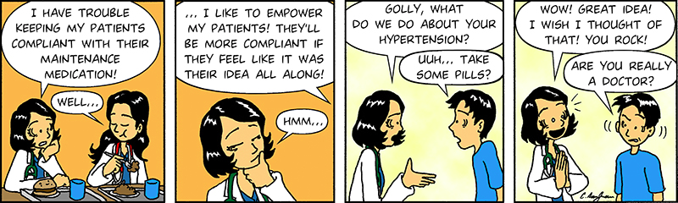
Improving doctor-patient experience

